Slide 1
He arotake i te pūnaha Tere-Rangi
AIR NAVIGATION SYSTEM REVIEW SECTOR REFERENCE GROUP
Phase 1: strategic objectives and principles
Signposts for Phase 2
Air Navigation System Review
August 24 2022

Slide 2
karakia
Tuia i runga, tuia i raro, tuia i roto, tuia i waho, tuia ki te ao mārama, tihei mauriora.
By sewing together the essence from above to the earth below may we all be bound together inside and out, may we bring understanding in all that we are and all that we do through togetherness, and the breath of life.

Slide 3
Chair’s welcome & introductions

Slide 4
Goals For this workshop
1. Reflect on and confirm stakeholder perspectives and feedback
2. Discuss the strategic objectives and guiding principles
3. Indicative focus areas for Phase 2
4. What’s next?

Slide 5
Contents
Cockpit voice recorder: Your thoughts on the current state and future strategic direction
Flight plan: Sharing the Panel’s initial thinking
Waypoints: Next steps

Slide 6
What we saw
Commitment to the system and aviation in New Zealand
Passion
Optimism
Energy
Enthusiasm
An unwavering focus on safety

Slide 7
What we heard
The system is safe
It has served us very well to date
There is huge potential to describe and maximise the benefits to New Zealand Inc
There is alignment on the drivers for change
The system is being disrupted, and that brings challenges and opportunities

Slide 8
Current state feedback
Multiple different airspace users with multiple requirements
International stage – we are well respected
Needs independent review
Focused on short – medium term
Vulnerable to jamming
Bad safety management
Competing interests
Stable
Expensive – reliant geopolitical solutions
Commercial focused rather than service focused
Under pressure
Inefficient
Going digital
Funding challenges
Not equipped for change
Diverse
Inflexible
Complex
ICAO non-compliant
(sounds) expensive
Siloed
Reliable and continuous service
General aviation needs better recognition and support
Inefficient
Technology advancing
Not resilient
What does Govt want?
Incohesive
Analogue
Lack of national interest view
Segregated
Lack of innovation
Labour intensive
Frayed edges
Changing, but not as quickly as needed
Gap at system level increasingly evident
Multi-faceted
Rigid
Critical for New Zealand
Role in national security system could be enhanced
A 1990s reform success ‘relatively’
Multiple purposes
Passenger-centric
Uncoordinated funding
Overly structured
No connection with industry
Structure is inhibitor
Lack of direction
Capital intensive
Well understood
Defined by airports
Well joined up
Unfair
No minimum level of infrastruct-ure
We provide a safe efficient service, and have managed through Covid, now we need to innovate for the future
In transition
Predictable
Essential for ensuring Aotearoa is connected domestically and internationally
Hard to add new capabilities
Barrier to entry
$
Conservative
Funding model wrong
Built on past experience
Infrastructure may need upgrading
Expensive & necessary
Under pressure
About to explode with ET
Lack of agility
Not system wide
Committed participants
Taken for granted
Strong legacy base
Unexploited opportunity
Stuck in the past
Cost to users
Constrained
Multi-dimensional
Designed for traditional users
Process driven
Complex demands
(sometimes) ad hoc
Resistant to change
Low-volume
Largely safe
Barrier to entry
Biased to certain traffic types
Safe
Adequate for purpose
Built on a shared paradigm
Risk adverse
Space for new innovations
Unwelcoming
Mixed direction
Regulated
Gaps
Innovation difficult
Conflicting objectives
Ad hoc solutions
National outcomes not certain
Not as safe as it could be
Inflexible
Moving towards new technology enablers which need policy support
Works in spite of
Safe
Closed source
Rigid airspace structure
Obligations to Pacific
Analogue
We make it work
Monopoly
Safe
Safe
Changing
Fragmented oversight
Not efficient
Full of energy and commit-ment
Lacking vision
Needs more precision nav options
Lacking resource
Aircraft compliance costs
Safe
Safe infrastructure for present use
Redundancy?
Analogue
Increasingly specialised
Lacks direction for future
Insufficient govt investment
Safe
Safe and efficient air traffic control service
Need to prepare for unmanned aircraft
Airways charging system is satisfactory
Silos
Lacking skills sets
Lack of consultation
NO VISION
Static (slow to change)
Multi-agency
Not inclusive as it could be
Under pressure new tech
Complex
Lacking resilience
Inflexible
Traditional
Unknown social value
Notes:
Recurring/common themes, and some examples of your comments. Remember we recorded these verbatim from your post-it notes.
Safety is the primary purpose of the system. You talked about needing a vision for the system, to get ready for and respond to the change that is coming.
Innovation you expressed in terms of opportunity, and also some frustration that the system is not as welcoming, as inclusive as it could be.
You identified the system as being nationally critical, but without a national interest view
Linked to this are ideas around Security and resilience, both in terms of the need for the system to be secure and also to contribute to delivery of those outcomes here and in our wider region
The system is complex and multidimensional, and there are competing drivers. Systems thinking is somewhat lacking in your view.
You highlighted capacity and capability issues, including lack of the skills sets needed. We heard mention of strategy, policy, regulatory, technical and operational gaps.
Investment in infrastructure, and a move toward promoting longer term thinking, particularly when the investments are multi-generational in nature.
This is not a broken system. It comes off a strong base, and you highlighted some key points here, too: making it work, the energy and commitment, and our strong international relationships and reputation.

Slide 9
Future state: your feedback
Cohesive
Clear system components
Airspace integration seamless
Demystified – greater awareness/ understanding from public
Airspace under separate control from ANSP
Dynamic
Efficient
Like roads main routes + on ramps off roads
20-30 years is too far out given the technology advancement rate
NSSWG has done work on MON
Enhanced governance and leadership
Net zero/ reduce emissions
Flex/nimble to tech/culture/
regulation
Infrastructure should be changed across the whole system
Open communication &
problem solving
Aviation infrastructure would need expansion
Trusted
Giving NZ inc competitive edge
Appropriately funded
Joined up
More integrated with transport sector
Safe
Sustainable funding (even if user pays)
New vision beyond NSS
Different public/ system mind sets
Efficiency and equitable funding
Rethought infrastruc-ture
Reliable
Flexible use of airspace
Fundamentally funded
Expanded services
Aligned internatio-nally
Resilient
Straight-forward processes
Aligned policies
Clear vison
Agile
Capable
Connected
Capex available
Tied into wider systems across NZ
(Still) safe
Important!
Effective
Segregated airspace
Govt understands value & opportunity of aviation
ANSP user pays but not for profit
Responsibility & control linked
Reducing single points of failure
Continuously evolving
Sensible funding
Increased access
Agnostic
Inclusive
Enabling
Adaptable (to new tech)
Embeds tiaki
Airspace optimised & prioritised
Enhanced resilience for all hazards/ threats
Systemic
Comprehensive ASAs with Pacific States
Resilient
Efficient
Can withstand external shocks
Safe
Risk-based
New tech welcome
Legally enforceable just culture obligations
Safe by design & intent
Proportionality
Fit for purpose
Vision in place (NZ)
Collaborative
Accessible info
New skills in place
Open!
Adaptable
Adaptable
More automation
Precision
“System” best in class
Cost effective
Innovative
Min level infrastructure specified
More entrants
Kids excited about aviation career prospects
Safe, flexible, efficient, sustainable
Expanded + improved infrastructure
Balance effective & efficient
Integrated
Open
Viewed as critical national asset
Int’l compatibility
Connected
Optimised airspace integration
Inclusive
Efficient
Clear assessment of safety impact of business decisions
Capable of managing change (incl. tech)
Importance recognised
Flexible/agile + able to respond effectively to change
Complies with all ICAO SARPs
Great vision
Sustainable principles
National interest supported
Cost-effective
Flexible in real time
Integrated
Trust of public
Safe & secure
Safe & efficient
Reliance AI
Allows innovation but controlled
Clarify responsibility of participants
All large operators have long-term strategy
Integrated crewed and autonomous
Enough capacity
National minimum service level
Level of safety
Good safety record
User defined as pax + freight
More integrated regulations
Well coordinated
Affordable aviation
Flexible
More global tech
Sustainable aviation
Path to gaining & retaining expertise
Dynamic
User pays is fine but should depend on pax + freight carried not provider
MoT approach is now 90% aviation
Not burden on users
Leadership at ICAO
Makes use of new technologies/ innovations
Innovative
Optimised
New digital enablers open up aviation to all
Collaborative
Internationally recognised
Driven by evidence
Systematic
Clear evolutionary pathway
Adaptable
Govt funding for green tech
Connected
Established outcome driven principles
World leading in safety + innovation
Innovative
Accountable (decisions can be challenged)
Competitive
Fully leveraging available technologies
Multi-air modal
Well resourced
Digital (c.f. voice)
Customer focused
International leader!!!!
Championing common good
Rational
International compatibility
Notes:
Safety: still important, and linked with value, trust, and the system being valued.
Leadership is clear, in terms of who has system stewardship in New Zealand, and how we perform on the global stage. You also highlight working together and taking having great vision, over the right timeframe!
You are thinking about a system that is flexible and adaptive, integration of new technologies, with and optimisation of what we already have, and continuous evolution
You see a system that is viewed as a critical national asset, delivering national benefits and that is secure and resilient, including through technological changes and increasing reliance on digitised systems
Sustainability in terms of funding and environment also came through.

Slide 10
this bit you did earlier

Slide 11
These ‘to’ statements, (with a touch of refinement) have informed the panel’s draft strategic objectives and guiding principles for the future state system….

Slide 12
Bearing in mind that…
Safety is paramount
The current system is a sound base for future development
What has served us well until now will not be fit for the future
Status quo is an option but means we’d go backwards

Slide 13
The proposed flight path
Primary purpose
Safety. Always
Path to the future
An enduring strategic direction
Strengthen the settings
Enable delivery of the what and the how, and the who
Establish the why
Notes:
This is the narrative structure in the Phase 1 report for the emerging strategic themes:
Primary purpose
High level direction
Workstreams / focus areas

Slide 14
Strategic objectives
Safe. This is the primary objective. Future concept of safety is dynamic, risk-based, and considers benefits. System level assurance and accountability for safety outcomes
Unified and collectively accountable. A shared direction of travel. System leaders work together. System performance measured against metrics that include aviation and national interest outcomes
Capable and resourced. The system has the people it needs and means of developing, attracting and retaining critical skills and capacity. System seeks out diversity and uses collaboration
Efficient. The system facilitates efficient operation and is an enabler of economic growth, social development.
Open, integrated, and accessible. Airspace is open to those who operate according to the rules. Safe, seamless integration of new technologies
Financially sustainable. Coordinated approach to long term investment, especially in core infrastructure. Pricing and charging is fair and transparent.
Environmentally sustainable. System decision-makers actively prioritises decisions to meet environmental objectives including carbon neutrality by 2050
Agile and innovative. The system fosters and attract innovation and investment to deliver benefits. It is recognised as forward-looking with clear competitive advantages
Connected. The system enables regional, national, and global connections for economic and social benefits
Secure and resilient. The system is protected from threats and vulnerabilities. It is recognised as a critical part of New Zealand’s emergency response capability domestically and in the wider Pacific region

Slide 15
Guiding principles
Transparency. Decision making processes are clear, justifiable, and includes mechanisms for consultation and scrutiny.
Te Tiriti o Waitangi. Te Tiriti o Waitangi principles inform decisions around the air navigation system. System level decisions reflect te ao Māori values and perspectives, including kaitiakitanga
Systems thinking. Decisions use a whole-of-system view of all relevant interests and impacts, including public good outcomes and national interests. Where decisions involve trade-offs, leaders consider impacts on and obligations of all relevant stakeholders
Interoperability and harmonisation. The system design will reflect international standards and practice, and supports the global rules-based system

Slide 16
Your thoughts…
Which of these do you think are most important? Most urgent?
Most interesting?
Best bang for buck?
What’s missing?
This Photo by Unknown Author is licensed under CC BY-NC

Slide 17
Phase 1 direction – focus areas
High level signposts: where we want to go
How we might get there is focus for Phase 2
Remember: high level, first principles
Focused on the settings and enabling a future-fit system

Slide 18
Policy and regulatory SETTINGS
System leadership and stewardship for strategy and policy
National interest
Policy and regulation that supports a safe, agile and responsive environment
- Interface across policy and regulatory frameworks: security, resilience, climate change…

Slide 19
Institutional settings
Focus first on fitness of and opportunities in the existing framework
e.g., oversight and monitoring arrangements and accountabilities
Mechanisms to build a shared ‘why’ for all parties in the system
Capacity and capability at an agency and system level
Examine how institutional cultures and values influence the system

Slide 20
Funding settings
User pays, plus… addressing vulnerabilities in the current settings
International models of funding for R&D, innovation
Funding for nationally critical infrastructure and services
Impact of current settings on long term investment

Slide 21
Review update
Sector group meeting and workshops: hearing from you
Panel meetings involving stakeholders and expert commentators
Commissioned research and advice: funding settings; Māori and iwi engagement
Meeting with the Associate Minister
Looking ahead: delivery of Phase 1, planning ahead for Phase 2.
Notes:
Brigid

Slide 22
ANSR Māori reference group
Membership: mātauranga Māori, Te Tiriti o Waitangi, flight crew, air traffic control, public policy, Crown Māori engagement
Scope: independent advice and support to include
te ao Māori perspectives
Principles of te Tiriti o Waitangi
Advice on engagement and collaboration with Māori
Potential for engagement with sector reference group in future.
Notes:
Danny

Slide 23
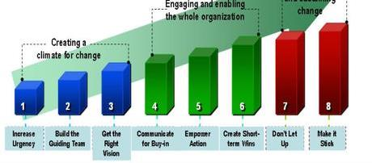
You already know that change requires tenacity….
This Photo by Unknown Author is licensed under CC BY-NC-SA

Slide 24
And it involves trade-offs
THEMES:
Strategy + leadership
High
QW
PI
PI
PI
PI
GC
PI
PI
GC
PI
PI
GC
Security + resilience
PI
PI
PI/GC
GC
PI/GC
QW
GC
GC
Capacity + capability
QW
PI
GC
GC
GC
GC
QW
QW
PI
PI
PI
QW
QW
GC
Sustainability
QW
QW
PI
QW
Funding & charging
QW
PI
GC
Safety
Strategic impact
Recall this…
Innovation
Society
TIMEFRAME:
QW
Quick Win (6-12 mths)
PI
Performance Improvement (1-3 years)
Low
GC
Game Changer
(3+ yrs)
Easy
Ease of implementation
Hard
Notes:
Can’t and won’t do everything
There will be prioritisation and trade-offs

Slide 25
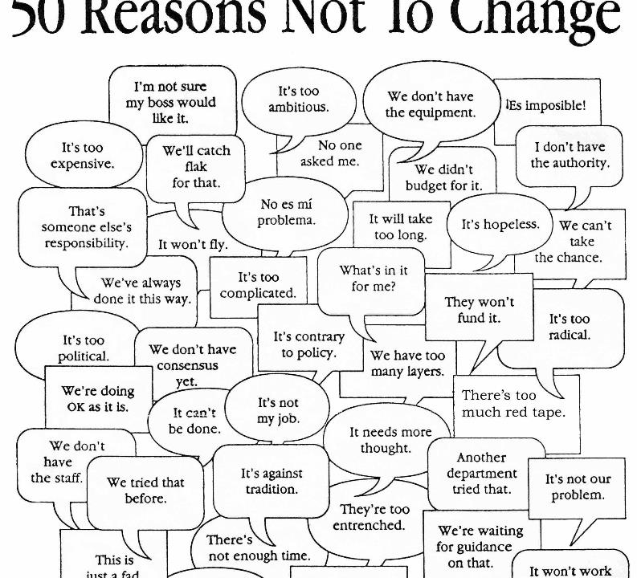
And that it’s really hard & it’s really worthwhile
This Photo by Unknown Author is licensed under CC BY-NC-SA

Slide 26
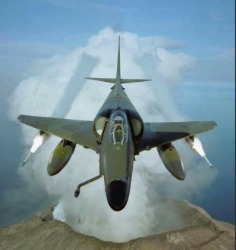
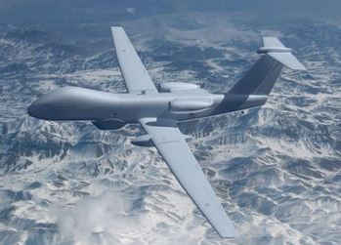
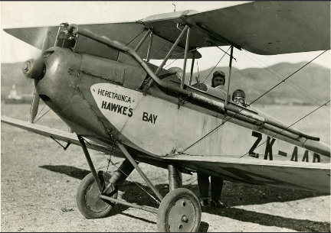
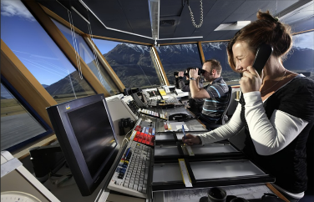
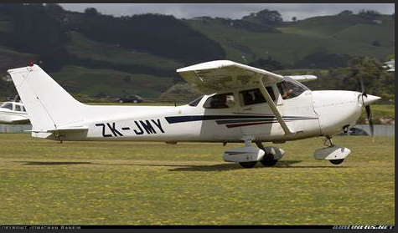
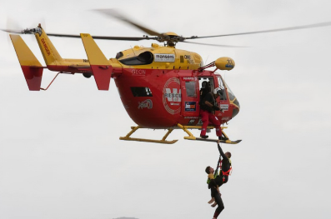
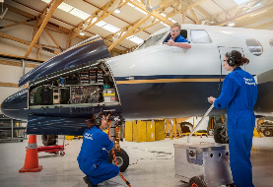
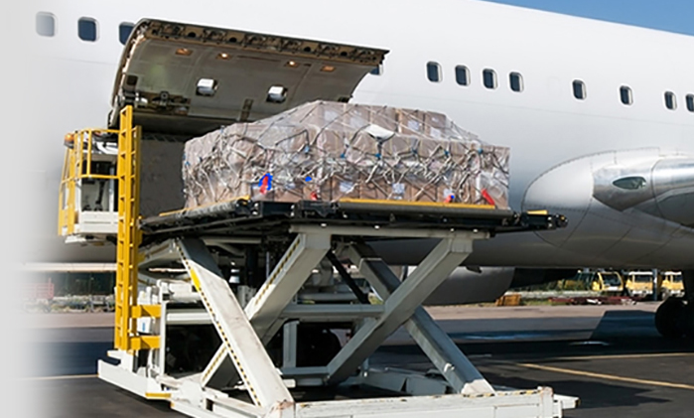
Source: MAD on New Zealand

Slide 27
Where to next & who is doing what?
…in the Review process?

Slide 28
What Will you see next?
Got feedback on the strategic objectives and principles?
Send to us by 2 September
We’ll refine the report to the Associate Minister
We’ll share the report once it has been noted by Cabinet in mid-October
We’ll share our approach to Phase 2

Slide 29
Session review – round the (virtual) room
After today’s session, what are you most worried about re the ANSR work?
What are you most positive about?

Slide 30
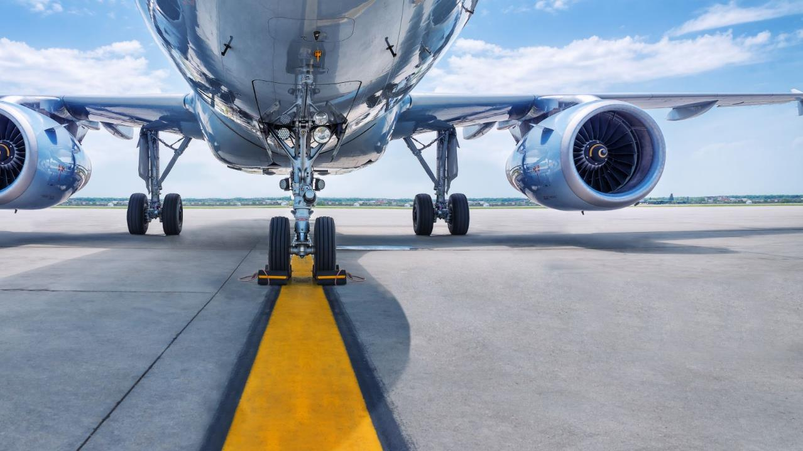
Thanks!

