Slide 1

Draft Government Policy Statement on Land Transport (GPS) 2021
An overview
Notes:
This slide pack will provide you with an overview of the draft GPS 2021. This presentation is primarily designed for our local government stakeholders who are partners in implementing the GPS, as we are unable to visit them in person on our national roadshow. However, we still hope it is helpful for members of the public or stakeholder groups, who we would also encourage to submit their views on the draft GPS.
The draft GPS 2021 is available on the Ministry of Transport website for you to read and provide feedback on until 11 May.

Slide 2
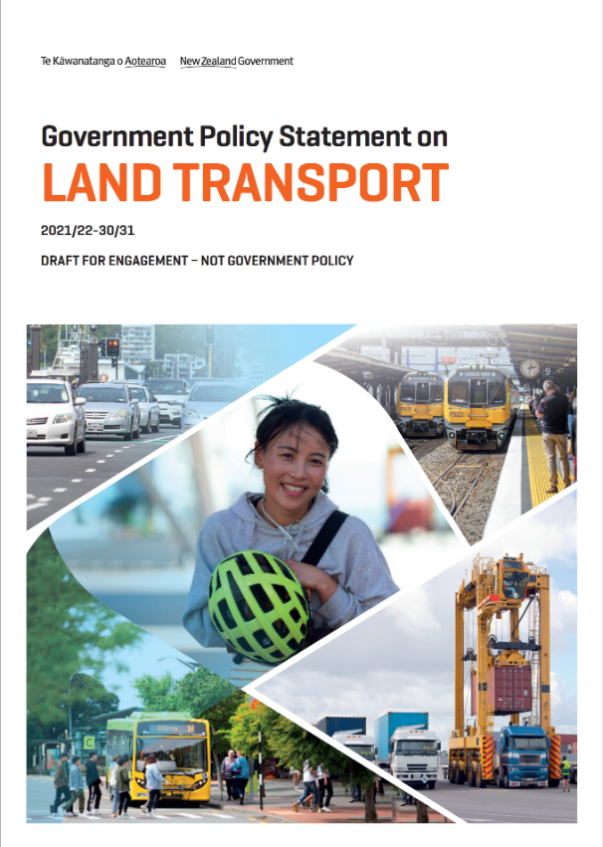
Why we are doing this presentation
Your feedback will help us develop the final GPS
Your views will inform the Minister’s decision-making
This session should help inform your RLTP process
Notes:
You are the people who put the GPS into practice through projects, so we’re here to make sure we’ve heard your early views to inform the Minister as he finalises the GPS.
We appreciate that many of you will be adapting to working from home. That’s why we have extended the GPS engagement period by two weeks to 11 May.
This will provide additional time as you come to terms with significant changes to your immediate priorities, operating models and individual circumstances.
We know some of you had already started working on your Regional Land Transport Plans (RLTPs) and that this work will continue. We know that lack of proper lead-in time to a GPS causes disruption for the sector and delays delivery. That’s why we are continuing with our public engagement. It’s important for us to get your views on the 10 year strategy set out in this draft GPS. It means the Minister can consider them alongside long-term impacts of COVID-19 on what Government wants to achieve from the land transport system – should they transpire.
If the GPS does not need to significantly change as a result of COVID-19, we want to make sure you had enough time to make sure RLTPs are consistent with the GPS.
We hope this session will help put you in a better position to provide formal submissions on the GPS, if you choose to do so.
We appreciate you may not have had the chance to read the GPS yet and that you will all have different levels of familiarity with the GPS so the presentation will go over:
The components of the draft GPS 2021: what’s been updated since GPS 2018 based on:
your feedback
policy developments
priorities and pressures
We’ll go over the strategic direction
Then we’ll give an overview of the funding allocated to activity classes and how this differs to other funding sources put forward by Government.
If you have questions that you need answering to help you write your feedback on the draft GPS then note them down as we go and send them through to the GPS email address and we’ll get back to you. We also have some frequently asked questions on our website.

Slide 3
What the GPS means for you
The GPS is your guide to the Government’s investment priorities
Providing feedback on the draft GPS will inform the future of national and local transport
The GPS fits within this funding framework
Government outlines objectives and funding for land transport
GPS
Crown appropriations
National Land Transport Fund
Waka Kotahi sets out projects to be funded from National Land Transport Fund
NLTP
Regional councils outline their transport priorities
RLTPs
Local share
Notes:
So what does the GPS mean for you?
Many of you are advocating investments and improvements for local transport on behalf of your communities
The GPS explains the Government’s direction of travel
It guides transport investment over the next decade – and is reviewed every three years
It influences decisions on how the National Land Transport Fund (NLTF) and local share is invested. It also explains the direct transport investments the Crown will make.
This funding framework shows that whilst the GPS sets the direction, it is Waka Kotahi the NZ Transport Agency, that gives effect to the GPS through the National Land Transport Plan. That includes projects from RLTPs, which are consistent with the GPS.
Funding pressures
Waka Kotahi have to manage projects needed nationally with regional demand and available revenue.
The NTLF doesn’t automatically increase to keep up with inflation, so when construction costs rise or emergency events occur, Waka Kotahi and councils either have to do more with less, or simply have to do less.
In developing GPS 2021, we have been very mindful of this. We have built the draft GPS 2021 from the bottom up, making sure to match the ambition in the front of the document to the available funding in the back, while ensuring that funding for essential maintenance is accounted for.

Slide 4
GPS is just one tool to realise Government’s vision
GPS
Local laws
Regulation
Action plan
Guidelines
PGF
Crown investment
Notes:
Bear in mind the GPS and NLTF are just some of the ways in which Government’s desired future transport system can be achieved.
For example, mezzanine strategies like the Road to Zero contain more detail on certain aspects of the Government’s vision.
Action plans for those strategies have more detail on the steps to be taken to implement them. For example:
Regulation may be changed to move us closer towards the future transport system
Guidelines may be produced to change practices on the ground
Funding might come from the PGF and so on

Slide 5
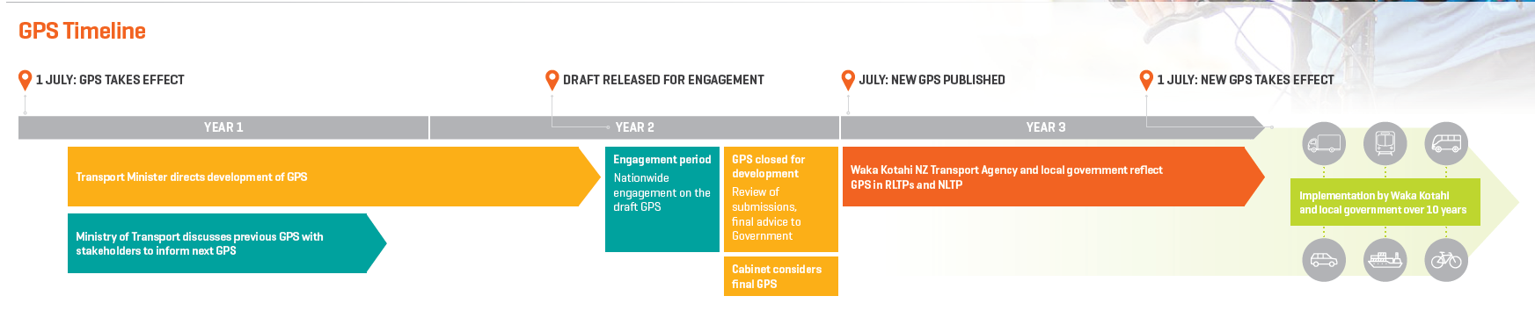
Where we are now
Notes:
Timeframes
For those of you not familiar with where we are at in the policy cycle – here are the broad timeframes for this work.
We will work to release a final GPS in the middle of this year. This should give you enough time to reflect the GPS in your local plans
Continuous programmes of work aren’t due to Waka Kotahi for prioritisation until December 2020
Final RLTPs aren’t due to be submitted to them until 30 April 2021, a few months before GPS 2021 comes into effect.
We took on board your feedback from the last GPS cycle at our roadshows in March and April 2019:
Some people told us that GPS 2018 wasn’t released early enough and there was general support for not progressing a second stage GPS 2018. We recognise that local government needs sufficient time to absorb the GPS to reflect it in their plans. So we have been working with the Minister and Waka Kotahi on the draft GPS 2021 since the middle of last year. The Minister decided a second stage GPS wasn’t necessary, as GPS 2018 was already a big change for the sector. ‘Second stage’ issues are instead covered in GPS 2021. We are aiming for a final GPS well ahead of when it’s due to be implemented.
As mentioned, we have sought to match funding and ambition in this GPS.
3. We have also tried to improve the structure of the document and make it clearer and easier to use.

Slide 6
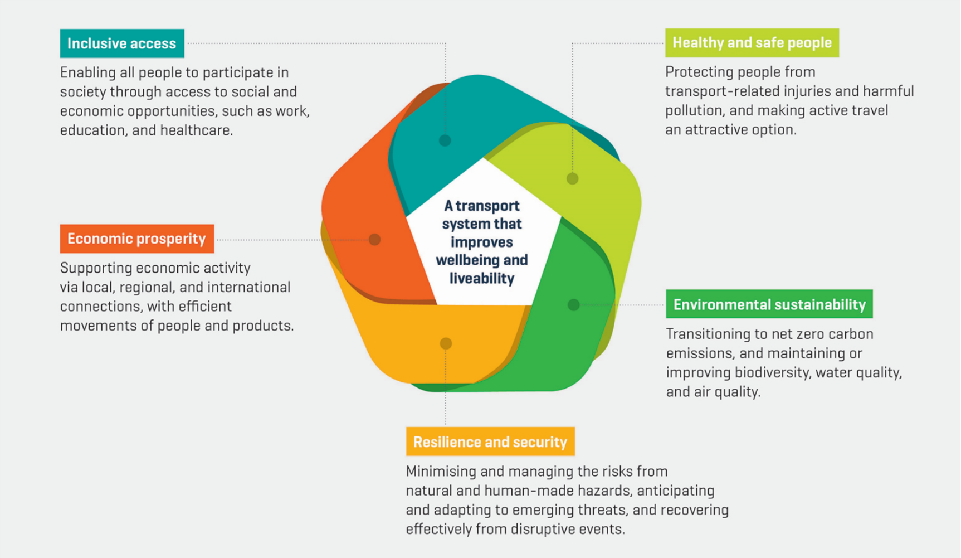
The GPS is informed by the Transport Outcomes Framework
Notes:
The role of the Ministry
We are the Government’s system lead on transport
We work to consider the long term outcomes for the entire transport system
These outcomes are described in the Transport Outcomes Framework which applies the Living Standards Framework to the transport system
This applies to the whole sector, not just land transport, so the Framework is underpinned by the essential principle of mode neutrality. This means that all transport modes need to be considered when planning, regulating and funding transport, and basing decisions on delivering positive social, economic, and environmental outcomes.
When GPS 2018 was written this Framework was still being developed, so a lot of people asked how the Transport Outcomes Framework and the GPS related. Whilst the Transport Outcomes Framework was developed by the Ministry, the Minister of Transport releases the GPS. In this draft, we have reflected which of the transport outcomes will be progressed by the Minister’s GPS priorities.
This is just one of the changes we made in response to your feedback.
Now that’s enough context, onto the headlines for GPS 2021.

Slide 7
Content of GPS 2021

Slide 8
Top takeaways
We want to hear your feedback
GPS 2021 consolidates the direction of GPS 2018
There are four new activity classes.
Rail and coastal shipping move us closer to mode neutrality
We appreciate your feedback
share your views today
submit or send feedback to gps@transport.govt.nz
Complete our online survey
  Before 5pm, 11 May 2020
Notes:
Before we jump into GPS 2021 – there are five things to know:
The draft is released for engagement to give the Minister an opportunity to consider your views before finalising it. We also want to hear whether you understand the document and find it usable.
The strategic direction builds on that of GPS 2018 - focusing on more specific priorities.
There are four new activity classes:
Road to Zero brings the safety related activity classes together to invest for a 40% reduction in road deaths and serious injuries
Public transport has been split into services and infrastructure activity classes
The Coastal Shipping activity class will support New Zealand coastal shipping and explore opportunities for improvement
The Rail Network activity class will be used to implement the Rail Plan by providing funding to KiwiRail to maintain and renew the national rail network.
Rail and coastal shipping have been brought into GPS 2021, as trailed in GPS 2018. They will receive small contributions from the NLTF. Ultimately, we want these modes to be competitive to offer a truly mode neutral transport system, and the best solutions can be chosen - not hampered by current transport network.

Slide 9
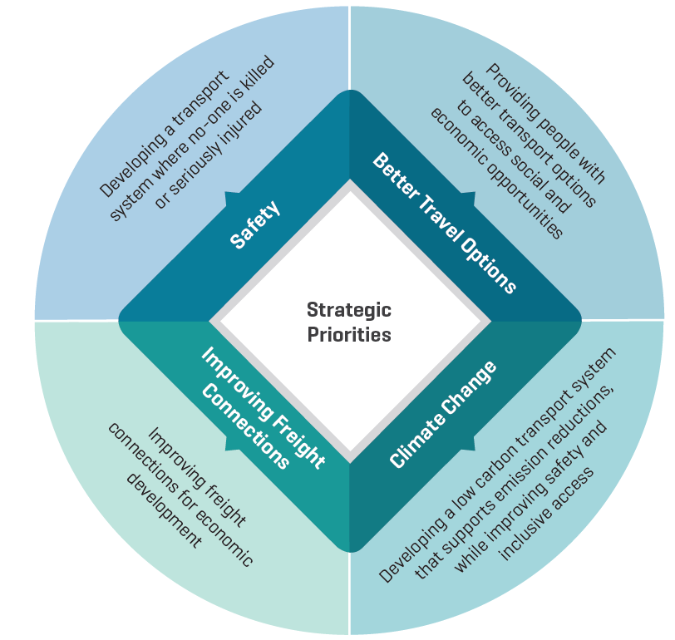
GPS 2021 strategic priorities
Notes:
Building on GPS 2018, GPS 2021 has four strategic priorities.
Safety
Safety has the same ethos as 2018, but refreshed to reflect the new road safety strategy - Road to Zero.
Under this we expect to see a reduction in deaths and serious injuries, ultimately this will be a 40% reduction by 2030.
As explained in the Road to Zero document there will also be improvements to footpaths, bike paths and - under rail investment - level crossings.
Better Travel Options
We unpacked Access from GPS 2018 so that one priority covers access for people, and the other covers business/freight access.
Under Better Transport Options, you’ll find continued support for towns and cities being developed in a way that means car journeys aren’t the first and only choice to get to where you need to go.
We expect more trips by 2031 to be made by public transport and active modes as a result of investment under this priority.
This in turn should reduce greenhouse gas emissions, and air and noise pollution.
As you know Government has already announced two large programmes that fall under this priority – the Auckland Transport Alignment Project and Let’s Get Wellington Moving.
We also expect to see progress on mode shift plans in the next four high growth urban areas.
Improving Freight Connections
Under Improving Freight Connections, we’re reinforcing the commitment to making sure freight routes are more reliable and resilient, to enable primary produce to be transported to where it needs to go, when it’s supposed to and undamaged by road conditions.
Government has already announced it’s commitment to resilient and reliable rail and taking the rail freight network out of managed decline. This fits within the Improving Freight Connections strategic priority to keep rail as a viable option for transporting freight.
Under this priority we’ll also explore whether more use can be made of coastal shipping to move freight, as a first choice but also as an alternative route when our resilience is tested.
Climate Change
In GPS 2021, the environment priority (continued from GPS 2018) is focused on Government’s commitment to tackle climate change, to contribute to meeting the objectives of the Paris Agreement on Climate Change by 2030.
We hope to see a slower rate of climate change as a result of the investments through the other strategic priorities, primarily through changing how we use land/plan urban spaces but also through shifting how we travel – both for business and leisure.
More direction will be given in the action plan government will create when the Climate Change Commission set the ‘budgets’ or ‘maximum targets’ for the amount of greenhouse gas emissions that can be made.

Slide 10
Changes to funding allocations
Around $10 billion over 10 years for Road to Zero
Over $1 billion per year for PT
Rail and Coastal shipping are now included
State Highway maintenance up 15%
Up to $8.5 billion for local road maintenance
Around $1 billion for walking and cycling
Notes:
Funding at a glance
We know that you’re always interested to hear where funding has increased or decreased but there is no single number that explains how funding has changed between 2018 and 2021.
Walking and cycling remains a key focus, with around $1 billion available over the next 10 years.
Around $10 billion is available over 10 years to build new infrastructure and safety investment to reduce deaths and serious injuries on our roads by 40 percent.
Investment in public transport will be over $1 billion per year, and will increase by up to 40 percent over 10 years.
The GPS now includes funding for the rail network and coastal shipping, to recognise the importance of these modes as alternative to roads for moving freight.
State highway maintenance will increase by around 15 percent compared to GPS 2018, with up to $10 billion in state highway maintenance signalled for the next 10 years to ensure our state highways are maintained to the right standard.
Local road maintenance will increase by around 5 percent compared to GPS 2018, with up to $8.5 billion in local road maintenance signalled for the next 10 years to ensure councils have sufficient funding to maintain their existing roads.
How this impacts your RLTP Process
We want your RLTPs to be the best plan you have for your area.
We want best business case guidance to be followed so that the options you put forward to tackle problems are the most appropriate solutions, not a reflection of funding ranges. And if the funding ranges are stopping you from achieving something that is really important not only for your region but for progressing the Government’s priorities for the country then we want to hear about it throughout the course of the GPS.
We also know it’s important to you to get clear reasons if your projects aren’t being funded and we’ve been working with Waka Kotahi on their Investment Decision-Making Framework review to check that improvements will be made. This is alongside revisions to the decision making framework to make sure it takes into account a much wider range of benefits than it has done in the past so that all modes can be fairly compared and assessed.
Waka Kotahi expects to release a draft approach for how they will prioritise investments in future towards the end of April (although the response to COVID-19 may have delayed this timeframe).
It will consult with all co-investors, key stakeholders, special interest groups and consultants who are involved in this process.
The draft prioritisation approach will be useful for Regional Transport Committees as they develop RLTPs. It will help them understand how activities may be prioritised for inclusion in the 2021-24 NLTP.
The draft prioritisation approach will be indicative only until the draft GPS is finalised.

Slide 11
Detail on new funding ranges

Slide 12
Activity Class Update
Activity class | Comparison with goals and structure of GPS 2018 classes
Road to Zero | New - incorporates road policing, and the safety promotion funding from the 2018 Road Safety Promotion and Demand Management activity class
Public transport services | Reframed the public transport, rapid transit and transitional rail activity classes
Public transport infrastructure | Reframed the public transport, rapid transit and transitional rail activity classes
Walking and cycling improvements | No changes
Local road improvements | No changes
State highway improvements | No changes
State highway maintenance | No changes
Local road maintenance | No changes
Investment management | No changes
Rail network | New - provides funding to KiwiRail to maintain and renew the national rail network
Coastal shipping | New - aims to increase the use of ships in moving domestic freight
Regional improvements | Removed – future investment will be through other activity classes
Notes:
Activity classes remain largely the same as GPS 2018; there are three new activity classes (rail network, coastal shipping and road to zero). Public Transport has been split into infrastructure and services. The regional improvements activity class has been removed.

Slide 13
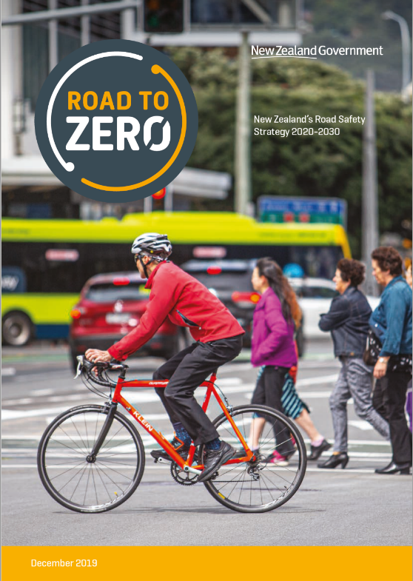
Road to Zero is a new activity class
What this means:
$10 billion for road safety over 10 years
  ~$1.2 billion investment in local road safety improvements
  ~$3 billion investment in state highway safety improvements
Funding priorities:
Roadside drug testing equipment
Road maintenance or upgrades
Road safety campaigns
Notes:
What this means
The Road to Zero activity class in the draft GPS is likely to result in an additional $1.2 billion investment in local road safety infrastructure, and $3 billion in state highway safety infrastructure.
When added to the local road and state highway improvements activity classes, total investment in road improvements will exceed that signalled by GPS 2018.
The Road to Zero activity class incorporates road policing funding, and the safety promotion funding from the Road Safety Promotion and Demand Management activity class from GPS 2018.
It also incorporates infrastructure funding previously delivered through the state highway improvements, local road improvements, and regional improvements activity classes.
This means that a wide range of initiatives that focus on improving the safety of road users may be eligible for funding, for example, more roadside drug testing equipment; road maintenance or upgrades; or road safety campaigns.

Slide 14
Public transport is now split by infrastructure and services
Changes for the public transport in the draft GPS 2021 separate:
  ongoing investment to support public transport services
  from investment in new public transport infrastructure.
GPS 2018
Public transport
Rapid transit
Transitional rail
GPS 2021
Public transport services
Public transport infrastructure
Notes:
Changes have been made to the public transport related activity classes. In GPS 2018, this class comprised public transport; rapid transit; and transitional rail.
Now there is public transport services to contribute to the ongoing funding of all types of public transport services, and new services, including rail and total mobility.
Public transport infrastructure comprises rapid transit, transitional rail and the infrastructure aspects of public transport from GPS 2018.
Splitting the previous ‘public transport’ activity class into two like this helps to:
reduce the crossover between activities from GPS 2018
allows the Government to be clear through the GPS whether the strong increase in public transport investment should be directed to improving the physical networks, or by improving service levels.
Rail investment
Metropolitan rail (Auckland and Wellington and certain inter-regional rail) will be funded through public transport infrastructure. This allows Waka Kotahi to consider new initiatives that improve the passenger rail network. Most regional rail projects will be continued to be funded from the Provincial Growth Fund, which is specifically for provincial growth, rather than the National Land Transport Fund that needs to weigh up options for the country as a whole.
Funding for operating of metropolitan rail (Auckland and Wellington) will come from public transport services
Funding for other parts of the freight rail network to take it out of managed decline will be through the rail network activity class.

Slide 15
Rail network is a new activity class
Improving the rail network is good for our roads
The new activity class will provide funding for KiwiRail to maintain and renew the national rail freight network, as per the New Zealand Rail Plan.
The NLTF is only one source of funding:
NLTF
Track user charges
Crown funding
$100-$120m p.a
$TBC
$TBC through Budget
Notes:
This is the first GPS to directly allocate funding from the NLTF to KiwiRail. You can find a presentation on our website (in the same area as the GPS) that explains the reasons and process behind this.
Allocating funding directly from the NLTFF to KiwiRail helps to implement the findings of the Future of Rail Review, which is/was a cross-agency project led by the Ministry of Transport, working alongside KiwiRail, Waka Kotahi, the Treasury, Auckland Transport, and Greater Wellington Regional Council to define and develop the future of rail in New Zealand.
This activity class is about contributing to a reliable and resilient rail scenario which is mostly for the rail freight network.
Ministers would sign off on the agreed level of spending but only once they have been advised by Waka Kotahi on KiwiRail’s Rail Network Investment Programme.
The NLTF is only one funding source to fund rail across New Zealand because rail is part of the land transport network. The Crown would provide the bulk of the funding, recognising that the network (a national asset like state highways) has been in decline for some years. People who use the railways will also pay.
It’s important to note that bringing freight rail into the GPS depends on legislation being passed.
The Rail Plan is also currently out for engagement, and the government is amending legislation to implement a new planning and funding framework. This legislation will need to be passed before freight rail could be funded by the GPS, as it would implement a new planning and funding framework for rail.
As mentioned on the previous slide, transitional rail projects begun under GPS 2018 will be delivered through the public transport infrastructure activity class.

Slide 16
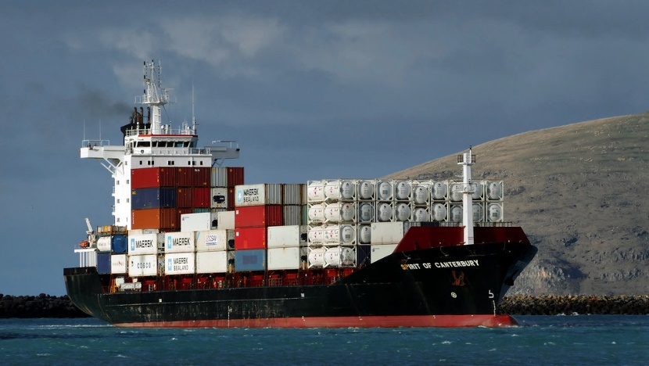
Coastal shipping is a new activity class
Coastal shipping is included in GPS 2021 to embed mode-neutrality in the transport system.
Notes:
As trialled in GPS 2018, coastal shipping has been included in the draft GPS.
It’s a safe and sustainable mode for transporting large, heavy cargo. It’s cheap and produces low levels of emissions compared to the alternatives because it is efficient at moving large amounts of cargo.
Ultimately, the Government’s expectation for investment in coastal shipping is to embed mode neutrality and provide another option of transport for freight transporters.
For now, the Minister of Transport wants to explore how to support New Zealand flagged coastal shipping to operate on a level playing field with other freight operators, and to enhance the sustainability and competitiveness of the domestic sector.
The initial three years of funding proposed in this GPS will include funding relevant research to see what future support for the sector may help achieve Government’s aims, understand the challenges facing coastal shipping, and to work with industry to address these challenges.

Slide 17
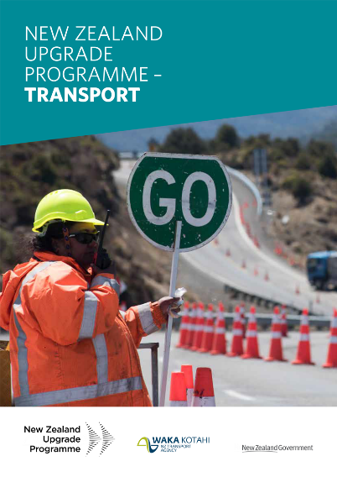
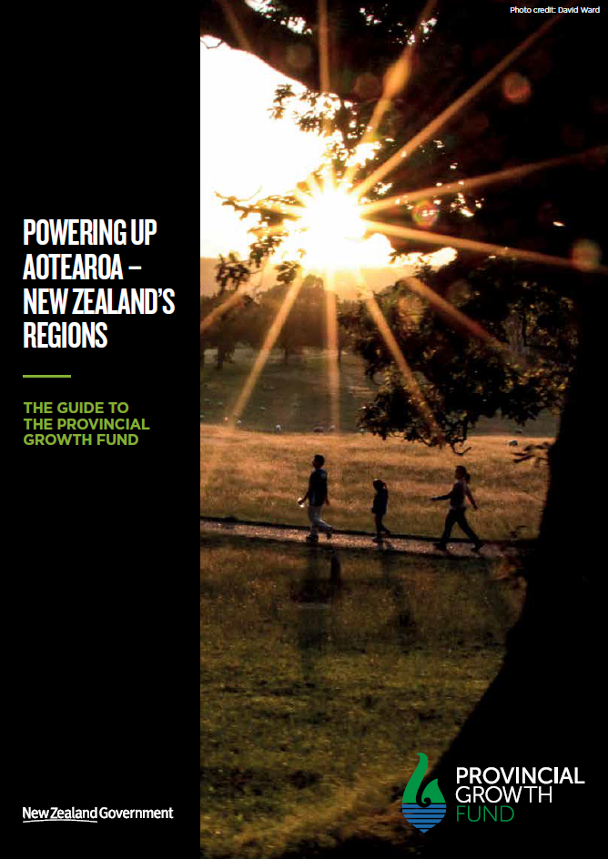
Other sources of funding
The New Zealand Upgrade Programme (NZUP)
$6.8billion for transport projects across New Zealand.
The Provincial Growth Fund (PGF)
the PGF is another source of funding available to support transport projects
Notes:
This Government announced it would provide funding from the Crown for infrastructure projects. This included some specific transport projects. This funding is in addition to the NLTF.
The New Zealand Upgrade Programme (NZUP)
Our modelling shows that around $1.8 billion of investment, which may have been met by the NLTF, will now be covered by the NZ Upgrade Programme over ten years.
This is equivalent to around five percent of the NLTF over ten years.
Unlike the GPS, the Programme invests money in progressing specific projects across the country that are due to begin in the next three years.
The projects in the package have been identified by Waka Kotahi as being priorities to the respective regions.
The Provincial Growth Fund (PGF)
The PGF is another source of funding available to support transport projects. It can advance projects that miss out on NLTP funding because nationally, they don’t come out as high priorities. But they might still be important for regional growth and development. Local land transport projects are expected to be considered for inclusion in the NLTP before they can be considered for PGF funding.
The PGF can be used to:
provide a top-up of local share for projects that will receive funding from the NLTF, but where local councils are financially constrained
bring forward projects which are not priorities for NLTF investment, but are strategically important to a region’s productivity potential
fund projects outside of the scope for NLTF investment, but which contribute to the objectives sought through the PGF and are aligned with the region’s transport strategy.

Slide 18
We want your input!
You can share it with us before 5pm, 11 May 2020:
  submitting or sending it to us (gps@transport.govt.nz)
  completing online survey – the link can be found at www.transport.govt.nz/gps
Notes:
If you any questions you want answered before you send your formal views on the draft GPS 2021, then check out the frequently asked questions on our website or email us and one of our team members will get back to you.
We would love to hear your thoughts on the draft GPS 2021 before 5pm on 11 May. We encourage you to use our online survey that’s also on our website (www.transport.govt.nz/gps.)

